Slide 1



First language attrition and professional re-immersion
Monika S. Schmid
Centre for Research in Language Development throughout the Lifespan, University of Essex
languageattrition.org
languageattrition
@MonikaSSchmid

Slide 2
transfer of skills between languages
  the paradox of professional migrants:
    we are aware that we need to learn the language skills underpinning professional skills acquired in a native language (L1)
    but if training and experience was done only in a second language (L2), we tend to assume we can also do it in our L1
  being a native speaker is regarded as a kind of ‘birthright’

Slide 3
transfer of skills between languages
  there are three problems with this assumption:
    specialised skills do not develop by themselves
    languages change, so even intact knowledge may no longer be up to date
    general skills may erode over time, due to non-use (L1 attrition)

Slide 4
ATTITUDES TO ATTRITION
  many people believe that attrition does not exist but is an affectation
  people who are publicly seen to have experienced L1 attrition are usually mocked and/or insulted on social media

Slide 5
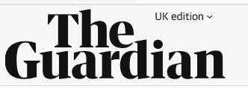
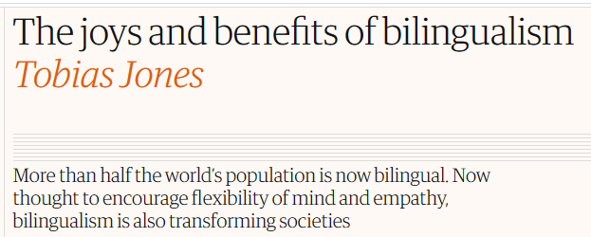
ATTITUDES TO ATTRITION
20.1.2018

Slide 6
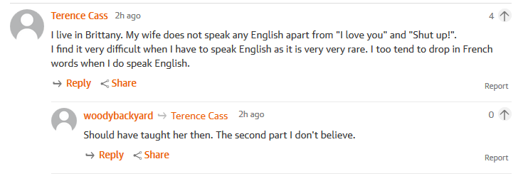
ATTITUDES TO ATTRITION

Slide 7
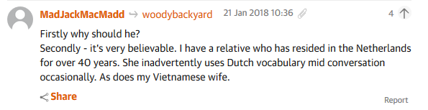
ATTITUDES TO ATTRITION

Slide 8
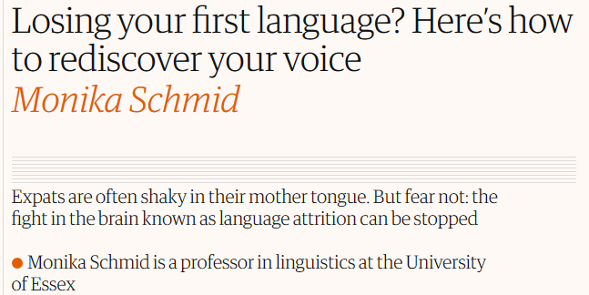
ATTITUDES TO ATTRITION
3.4.2018

Slide 9
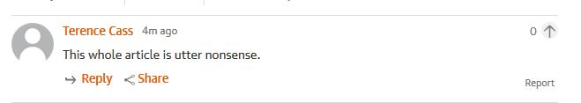
ATTITUDES TO ATTRITION

Slide 10
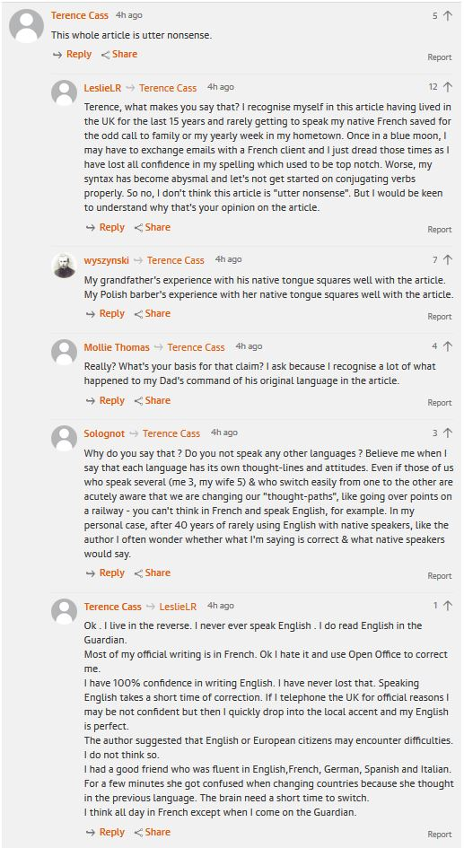
ATTITUDES TO ATTRITION

Slide 11
ATTITUDES TO ATTRITION

Slide 12
ATTITUDES TO ATTRITION

Slide 13
ATTITUDES TO ATTRITION
  many people believe that attrition does not exist but is an affectation

Slide 14
ATTITUDES TO ATTRITION
(…)

Slide 15
ATTITUDES TO ATTRITION
  many people believe that attrition does not exist but is an affectation
  … including people who, two months earlier, claimed to experience it themselves…
  what chance have we got…?

Slide 16
WHAT TO EXPECT WHEN YOU’RE ATTRITING
  you may produce:
    sentences that go badly wrong
    very disfluent speech (pauses, hesitations, uhm etc.)
    borrowings and switches
    inappropriate language (request-making, politeness)
    a more or less pronounced foreign accent
    very weird expressions

Slide 17
WHY IS THIS A PROBLEM?
  we gauge other people’s functioning (cognitive skills, intellect, capability, …) based on how they speak
  this has a big impact for L2 users
  but it can also be a problem in the native language

Slide 18
fluency and hesitation
  all naturalistic spoken speech has disfluencies (pauses, erm, fillers such as ‘like’, ‘you know’ etc.)
  not all of these are indicative or problems of retrieval or speech production (they also structure the message)
  attriters use more hesitations, some of them in places where monolinguals don’t
  appear less confident (and, therefore, less competent)
Schmid, Monika S. & Kristy Beers Fägersten. (2010) Fluency and language attrition. Language Learning 60:4, 753-791.

Slide 19
vocabulary
  attriters tend to overuse more frequent words and underuse rarer (‘more sophisticated’) ones
  a broad vocabulary is often used to ‘dazzle’ and create an impression of expertise
  appear less expert and less intelligent
Schmid, Monika S. & Scott Jarvis (2014) Lexical first language attrition. Bilingualism: Language and Cognition 17(4), 729-748.

Slide 20
grammar
  attriters sometimes have a preference for ‘more straightforward’ grammatical structures
  main clauses instead of subordinate ones
    can reduce the processing load (easier to keep track)
    some languages have different word order in main and subordinate clauses (easier to stick to one pattern)
  “John was tired. He went home.”
  “John went home because he was tired.”
  can create impression of less analytic/strategic thinking

Slide 21
grammar
  attriters sometimes have a preference for ‘more straightforward’ grammatical structures
  overt vs. null pronouns
    “Where is John?” – “He’s at the hotel.”
    Dónde está Juan?” “Está en el hotel.” (lit.: “Is at the hotel.”)
    Dónde está Juan?” “Él está en el hotel.”
  overt pronoun would not be used unless contrastive or emphatic
  attriters have tendency to overuse pronouns where monolinguals wouldn’t
  can create impression of overstating the obvious, not being attuned to informational needs of interlocutor
Gürel, Ayşe. (2002). Linguistic characteristics of second language acquisition and first language attrition:
Turkish overt versus null pronouns. PhD dissertation, McGill University Montréal.

Slide 22
WEIRD THINGS MIGRANTS SAY
  structures and idiomatic expressions are literally translated:
    English: to run for office, to run short of something
    Spanish: *correr para gobernador
    German: *ich renne kurz an Briefpapier

Slide 23
more subtle aspects of ATTRITION
  attrition does not just concern vocabulary, accuracy or fluency
  each language has its own conventions and (mostly) unwritten rules on how to interact
  for example: familiar and polite pronouns (the T-V distinction)
  many languages make this distinction

Slide 24
pronouns of address
English
French
German
Spanish
Dutch
I
je
ich
yo
ik
you
tu
du
tú
jij
he, she, it
il, elle
er, sie, es
él, ella
hij, zij, het
we
nous
wir
nosotros
wij
you
vous
ihr
vosotros
jullie
they
ils/elles
sie
ellos, ellas
zij

Slide 25
pronouns of address
English
French
German
Spanish
Dutch
I
je
ich
yo
ik
informal
you
tu
du
tú
jij
he, she, it
il, elle
er, sie, es
él, ella
hij, zij, het
we
nous
wir
nosotros
wij
you
vous
ihr
vosotros
jullie
formal
they
ils/elles
sie
ellos, ellas
zij

Slide 26
pronouns of address
English
French
German
Spanish
Dutch
I
je
ich
yo
ik
informal
you
tu
du
tú
jij
he, she, it
il, elle
er, sie, es
él, ella
hij, zij, het
we
nous
wir
nosotros
wij
usted
you
vous
ihr
vosotros
jullie
formal
they
ils/elles
sie
ellos, ellas
zij

Slide 27
pronouns of address
English
French
German
Spanish
Dutch
I
je
ich
yo
ik
informal
you
tu
du
tú
jij
he, she, it
il, elle
er, sie, es
él, ella
hij, zij, het
u
we
nous
wir
usted
wij
you
vous
ihr
nosotros
jullie
formal
they
ils/elles
sie
vosotros
zij
ellos, ellas
ustedes

Slide 28
WHEN TO USE THESE PRONOUNS
  … it’s complicated!
  e.g. German:

Slide 29
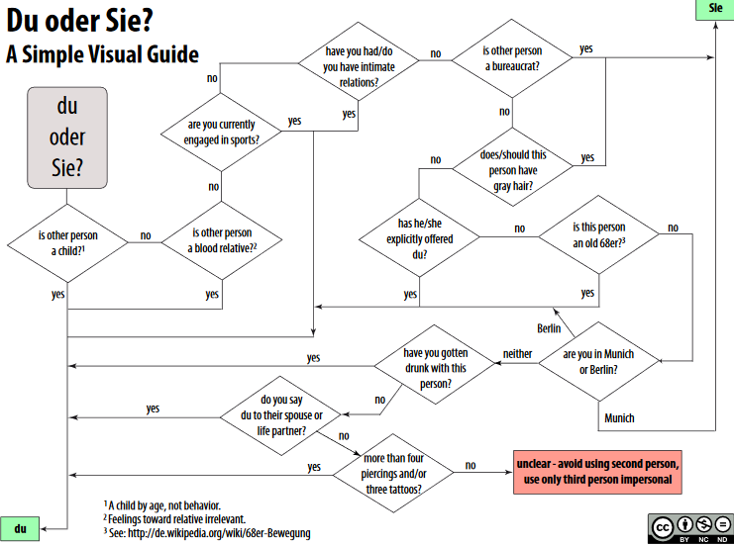
  https://htwkbk.files.wordpress.com/2010/01/du-oder-sie-a-simple-visual-guide.pdf

Slide 30
WHEN TO USE THESE PRONOUNS
  … it’s complicated!
  e.g. Dutch:
    many people use formal pronoun to address grandparents and parents (unthinkable in German, linked to age and background)
    married couple: he addresses his own parents with formal pronoun, she addresses her in-laws with informal
  e.g. French:
    Simone de Beauvoir, Les Mandarins: husband uses tu to wife, she uses vous to him
  https://htwkbk.files.wordpress.com/2010/01/du-oder-sie-a-simple-visual-guide.pdf

Slide 31
WHEN TO USE THESE PRONOUNS
  can be difficult even for monolinguals
  tricky for attriters for three reasons:
    we have changed (we are older than when we left, may have different social position)
    our language has changed (we are used to the conventions of our second language)
    the language of our home country has changed (many languages have trend towards more use of informal)
  however, getting it wrong can be disastrous!

Slide 32
EVEN more subtle aspects of ATTRITION
  politeness isn’t just a matter of pronouns, of course:
    “I can only fall silent because thirty seconds into the conversation, I have already failed at an important task: while I was bowing and saying hello, I was supposed to have been calculating the other person’s age, rank, and position in order to determine how polite I should be for the rest of the conversation.”
    (Mori, K. 1997. Polite Lies: On being a woman caught between two cultures. New York: Henry Holt.)

Slide 33
STILL more subtle aspects of ATTRITION
  we use language to establish relationships and demarcate our roles in these relationships
  choice of style, body language etc. vary depending on which role we are in
  we learn how to project a professional persona due to experience (most of us have never been taught this)
  it is a dangerous fallacy to assume such knowledge translates between languages!

Slide 34
MORE STILL more subtle aspects of ATTRITION
  styles and conventions of (professional) interaction vary between languages:
    body space/distance
    how to make a polite request
    how to offer to do something
    …
  the way this is done in one language can appear rude, pushy, overly ingratiating, … in another

Slide 35
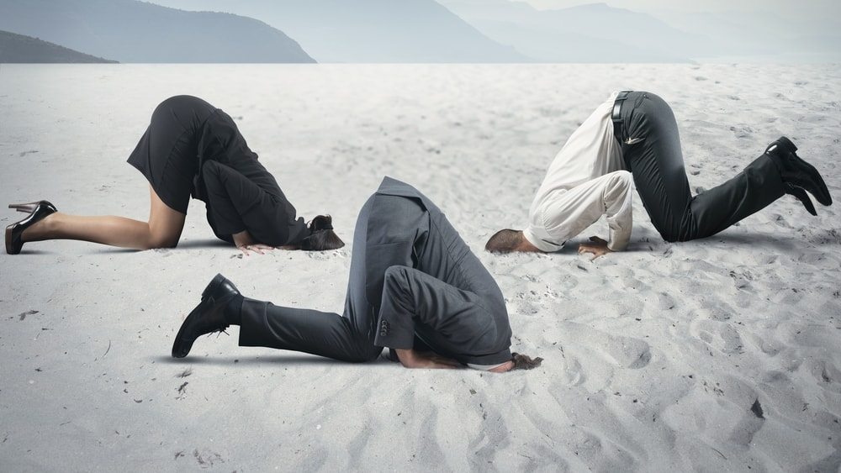
SO, what should we do...?
  not this!

Slide 36
SO, what should we do...?
  not this!
  nor this!

Slide 37
SO, what should we do...?
  become aware of what is going on
  if you have to write an important letter, ask someone to read it
  if you have to speak your native language in an important setting (e.g. job interview)
    rehearse the situation
    if possible, immerse yourself in the language for a few days beforehand
  don’t be afraid to say if you cannot remember a word or are unsure what it means

Slide 38
SO, what should we do...?
  … and if people still don’t believe you, send them here:
    https:/languageattrition.org
    www.facebook.com/languageattrition

