Slide 1
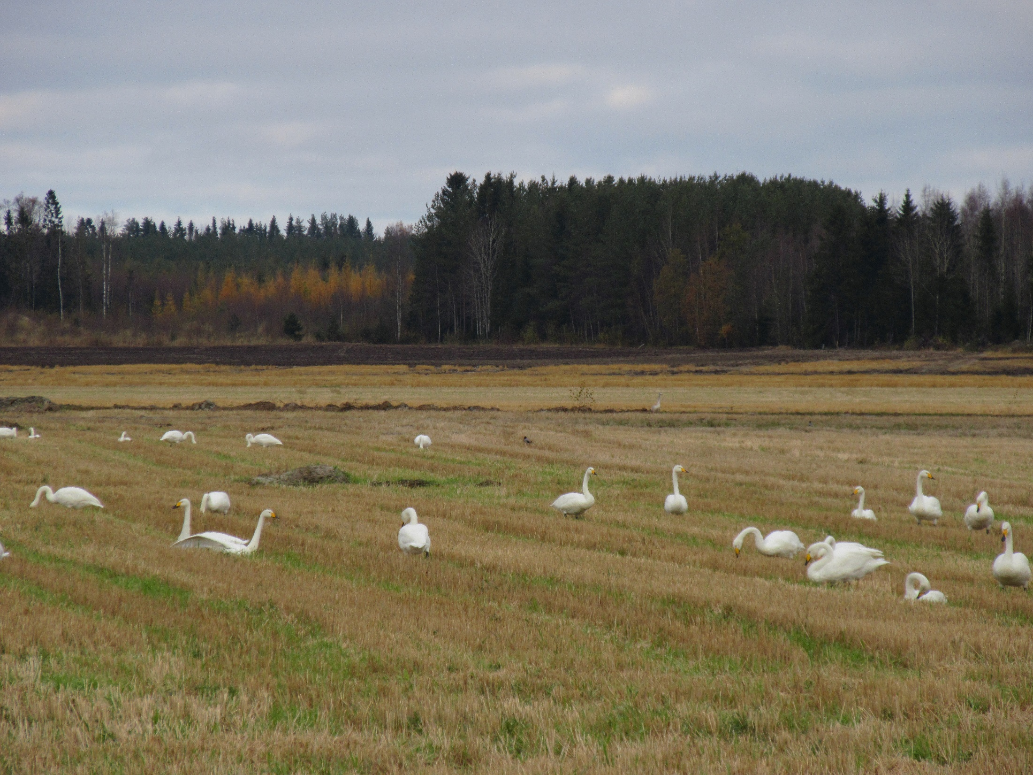
Official bilingualism, monolingual integration training and multilingual lives – challenges for integration policies
Sari Pöyhönen
University of Jyväskylä, Finland

Slide 2
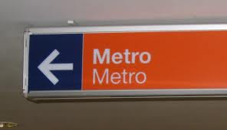
Official bilingualism in Finland
“The national languages of Finland are Finnish and Swedish.”
    Constitution of Finland. Section 17 - Right to one's language and culture
Population of Finland (5,5 million)
  87.6% Finnish-speakers
  5.2% Swedish-speakers
  0.1% Sami-speakers
  7.1% Speakers of foreign languages
No official statistics on bilingualism or multilingualism

Slide 3
Jag bor i Oravais (2015-2018), ongoing
Multi-sited team ethnography in Swedish Ostrobothnia, Finland
  Explores persons seeking asylum and the ways in which they tell about their everyday life at the reception centre and other local venues.
  Analyses the significance of Swedish and Finnish in research participants’ lives and discusses their lived experiences within wider political contexts and social structures.
  Produces research findings to prevent ad hoc decisions and structural seggregation

Slide 4
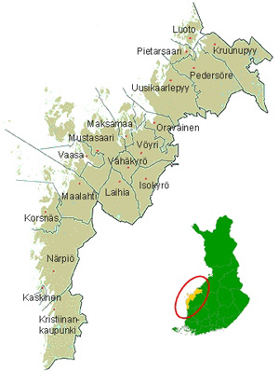


Slide 5
Monolingual integration in Finland
  Requirement for proficiency in one of the national languages
  Finnish as the predominant language of integration even in Swedish-dominant areas
  Asylum seekers as outsiders: not entitled to integration services, but required to engage in education or to work
    Finnish lessons

Slide 6
“Finland is a bilingual country. Its official languages are Finnish and Swedish. Integrating in Finland will be easier, if you can speak the language of the municipality of residence. Learning the language of your new home country is vital. It will be easier for you to find a job if you know Finnish. Some five percent of Finnish people speak Swedish as their native language.”
  Ministry of Employment and the Economy 2012: 12.

Slide 7
“Swedish-language integration may be a good choice for you, if:
  You live in an area with many Swedish speakers.
  You have family members or relatives who speak Swedish.
  You already speak some Swedish.
Swedish language skills could be useful when you look for work. However, please note that most jobs require proficiency in Finnish. Even if you choose Swedish-language integration training, you should also study Finnish at some point. […] According to law, you have the right to choose Finnish or Swedish as your integration language.”
  Ministry of Economic Affairs and Employment 2018: 29.

Slide 8
Forced migration & belonging
  Perceptions and constructions of belonging and ‘integration’ (Urry 2000; Giddens 2006; Phipps 2016; also Grzymala-Kazlowska & Phillimore 2017)
    Class and other identity inscriptions (Anthias 2012; Block 2014)

Slide 9
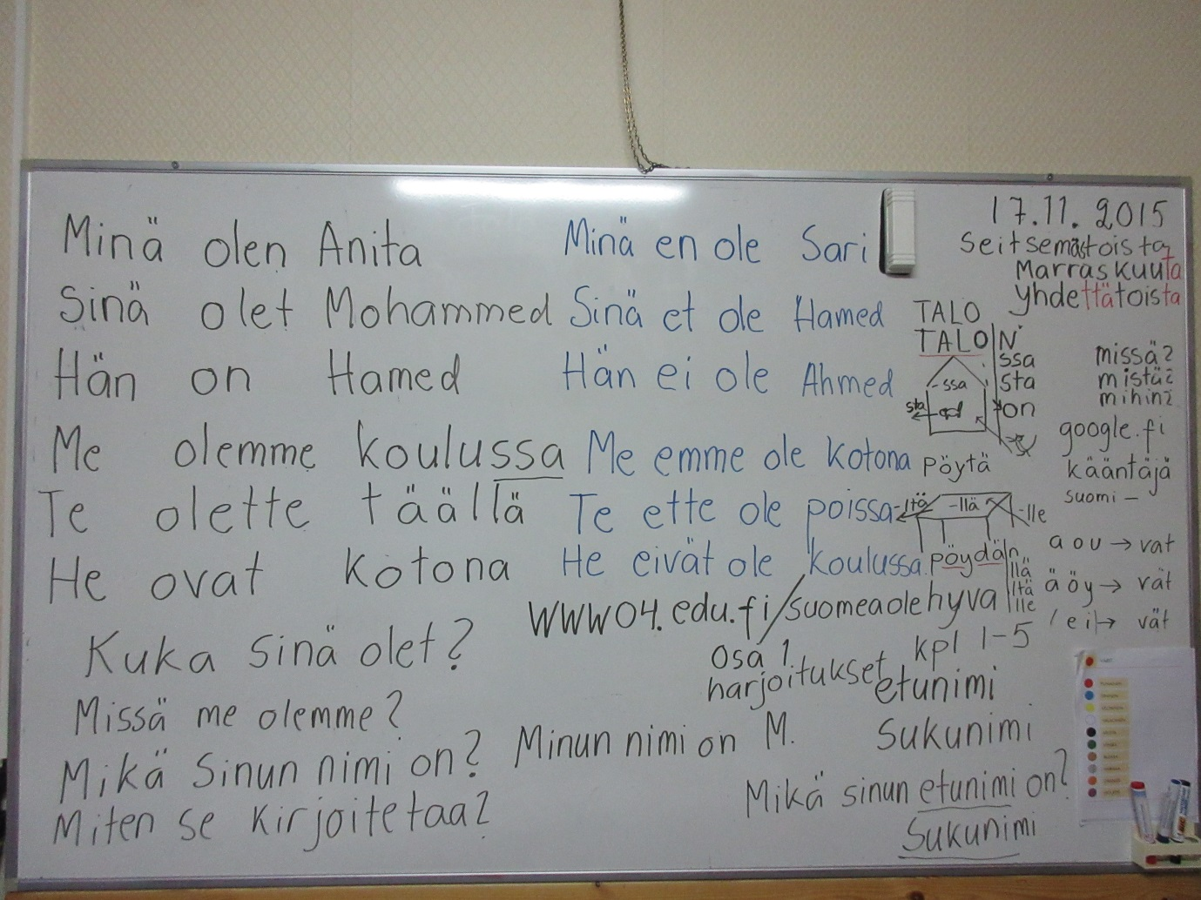
4 lessons a week
Obligatory teaching of Finnish at the reception centre
Feeling of being isolated
”Old time school”
  Similar teaching methods for different needs; shortage of resources and pedagogical expertise
  Language ideologies; normative understanding of ”proper Finnish”

Slide 10
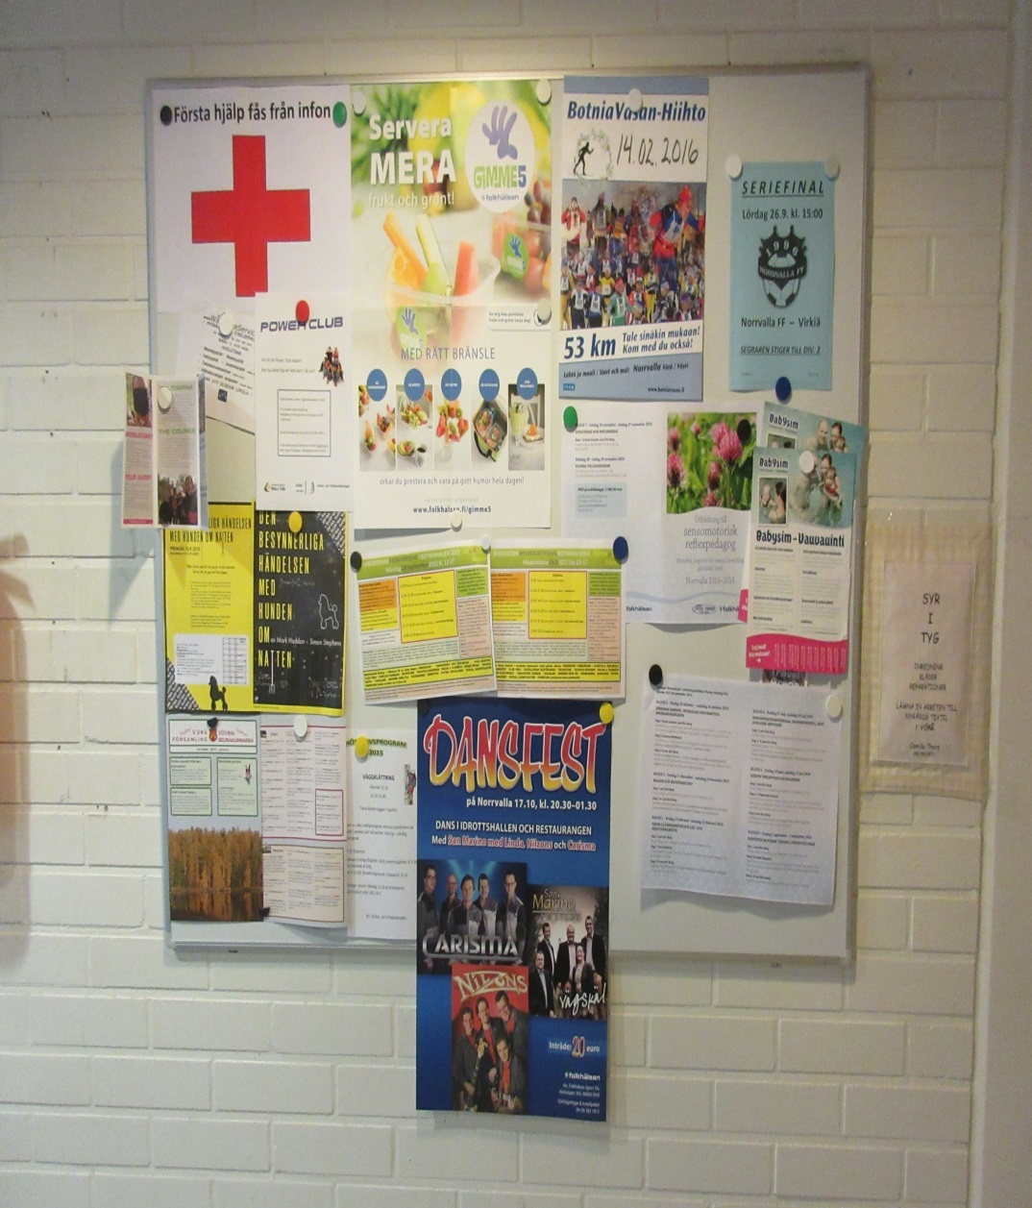
20 lessons a week
Folk high school Norrvalla in Vörå, project funding
Possibilities to meet local people
New meaning in life, daily routines
Free lunch
Swedish felt easier than Finnish
Course was intensive but far too short (8 weeks)
Motivation to go back to the ”school” was very low

Slide 11
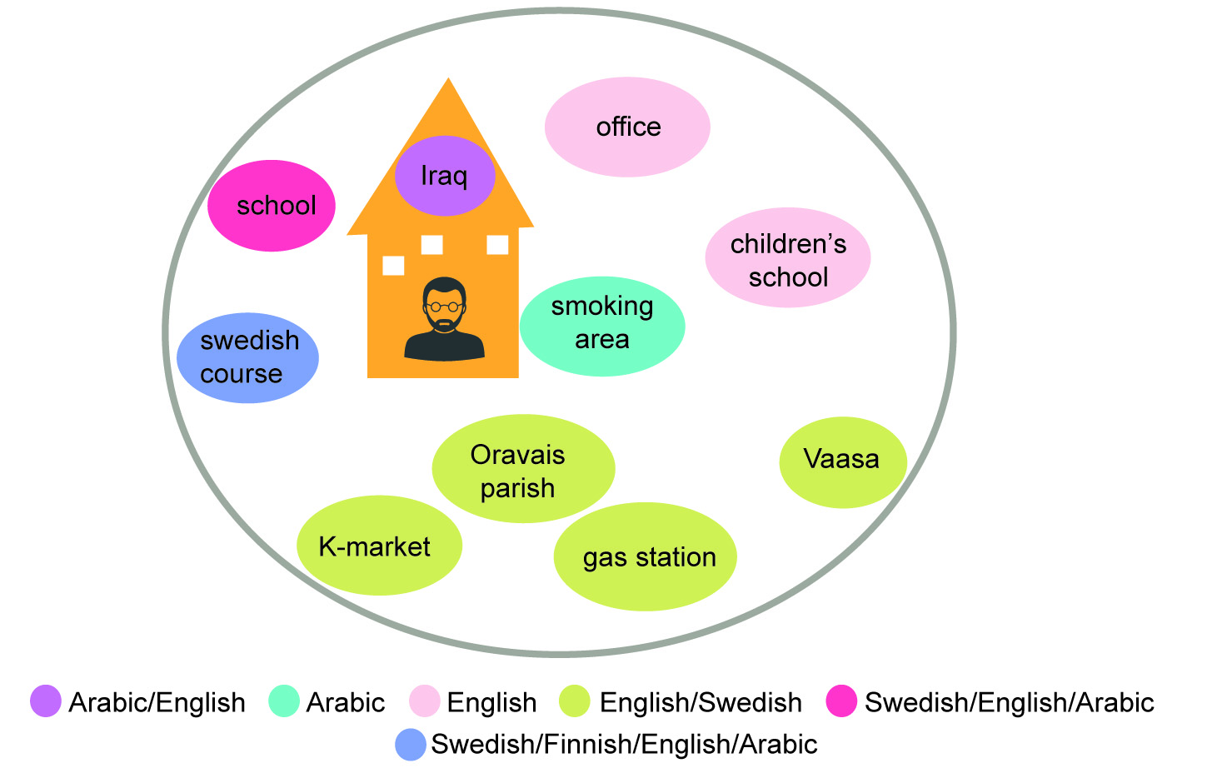

Slide 12
Implicit language policy decisions
MIGRIs implicit and explicit roles in the language (education) policy
  Integration is not the goal of reception centres
  Language education for internal security
Swedish as shared language between co-workers and volunteers
Swedish courses provided by other, non-governmental stakeholders

Slide 13
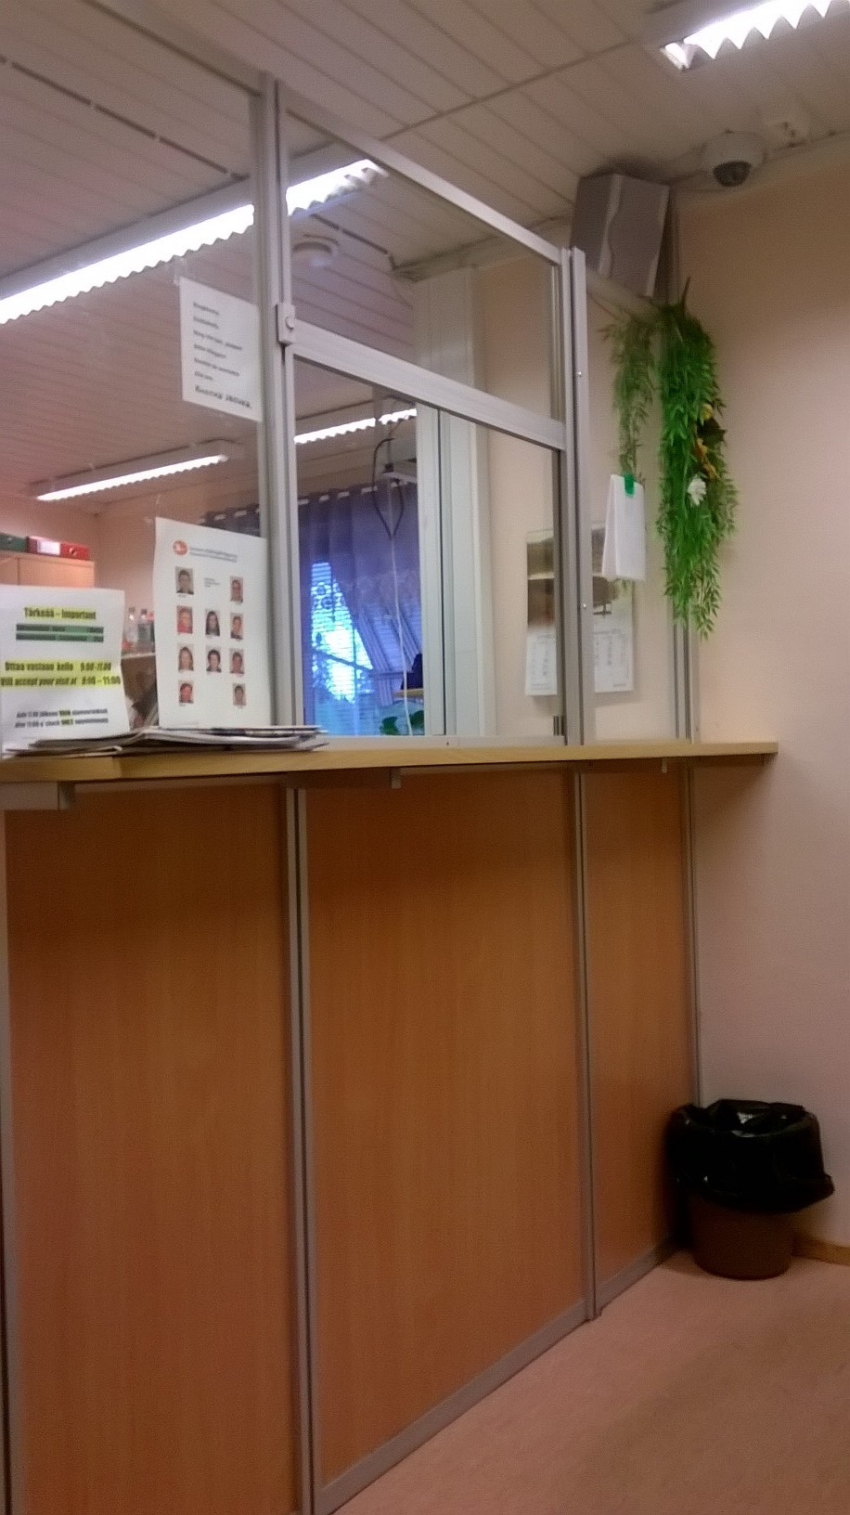
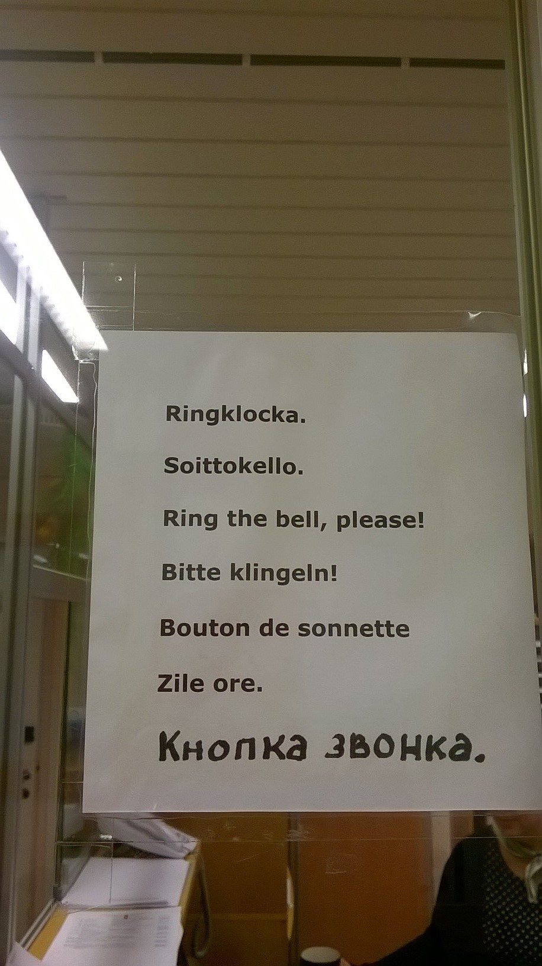

Slide 14
Home language
The trouble with variables such as ‘home language’ [in policy research on language in education] is that they are established as unchecked assumptions and turned into powerful explanatory factors, while, in actual fact, they remain poorly argued and fragile assumptions.
(Blommaert 2017: 2)

