Slide 1

Language as a Value: from Languaging to Translanguaging in a Multilingual Society
Prof. Sanita Lazdiņa
Rēzekne Academy of Technologies, rēzekne
National Centre for Education in Latvia, rīga

Slide 2
Overview
1 Language as a Value and Valued Languages
2 A Short Insight into the Education Reform in Latvia (2016-2021)
2.1 Language Planning and Management in the Education Domain
2.2 Language Ideologies, Beliefs, Attitudes (Diverse Perspectives)
2.3 Language Practices at School: Real Life vs. Expectations
3 Short Summary

Slide 3


- Why is there language?
Surviving, communication, cooperation
- Which language(s) do we assign value to?
Linguistic, cultural, ethnic identity (teachers’ perspective)
Usage value (more students’ perspective)
Valued knowledge – for which purposes?
1 Language as a Value. Valued Languages

Slide 4
2 A Short Insight into the Education Reform in Latvia (2016-2021)
Since 2016, the National Centre for Education in Latvia has been conducting the European Social Fund project “A Competences Approach to Learning Processes” (Skola2030).
Regarding language education, the project hopes to identify successful ways in which to teach Latvian with the following aims in mind:
to develop students’ literacy and pluriliteracy in the understanding that Latvian is also a tool for deeper learning and understanding other subjects;
to support students’ active involvement in exploring and describing linguistic structures while learning Latvian and other languages;
to develop students’ individual personalities through expressing oneself in one’s own language;
to develop students’ transversal skills, etc.

Slide 5
2.1 Language Planning and Management in the Education Domain
2018 National Curriculum for Primary Schools (grades 1-9) and
2019 National Curriculum for Secondary Schools (grades 10-12)
«Big Ideas» in the section «Languages»:
  1st part of the curriculum: Communication in Context
  We communicate by listening, speaking, reading and writing to process and provide information, express emotions and build relationships.
  Each communicative situation has a context that determines the content, form and influences the choice of a particular language medium.
  Mother tongue is the basis for learning other languages, while knowledge of other languages contributes to better comprehension of the mother tongue.

Slide 6
2.1 Language Planning and Management in the Education Domain
Field: «Languages»: parts of the curriculum:
Primary school | Secondary school
Communication in Context Text Comprehension and Production Language Structure | Language and Society Media, Language and Impact Stylistics Language Structure

Slide 7
Examples from the New National Curriculum
national curriculum for primary schools (grade 9)
national curriculum for secondary schools
Communication in Context
Able to communicate and interact with people from different cultures. Adapt your speech to non-native speakers of Latvian, for example, by choosing the appropriate speech rate, vocabulary and simple syntactic constructions. (1.1.8)
Language and Society
Describes the language situation in Latvia, analyzing the State Language Law, studying the status of the Latgalian written language and the Liv language, as well as the role of the minority languages among the Latvian population. Evaluates one’s own language and that of others in situations of practical use. Offers solutions to promote the use of the Latvian language in Latvian society. (1.1)

Slide 8
2.2 Language Ideologies, Beliefs, Attitudes (Diverse Perspectives)
Language ideologies (societal) and attitudes (individual) about language(s) and their use (language values)
Conscious and unconscious values
  Language ideologies systematically associate language choices and speakers with e.g. economic, political, and moral/ cultural dimensions

Slide 9
2.2 Language Ideologies, Beliefs, Attitudes (Diverse Perspectives)
Societal discourses (interviews, comments, discussions in different media) regarding curricula «Latvian language»:
«Latvian will be taught as all foreign languages; 2/3 is planned for developing communicative skills and only 1/3 for grammar» (TV programme «Kultūršoks», November 2018)
«The downgrading of the status of the language indicates that it is a welcome move for potential migrants who do not know the Latvian language. The key to the degradation of the status of the Latvian language in the project is its adaptation to existing and potential migrants» (from an interview with a sociolinguist in the newspaper «NRA», May 2018)

Slide 10
2.2 Language Ideologies, Beliefs, Attitudes (Diverse Perspectives)
Some examples from focus group interviews regarding the co-existence of languages and cultures
Research project, Latvian Language Agency, 2017-2020
Pupils’ perspectives (examples):
1. (..) Then it is not allowed to mention foreign films in writing argumentative essays. We are already writing in Latvian, and I think if there is a good idea in that movie that could be used as an argument - why not. But no.
2. And then there is the thing like, when comparing the 9th and 12th grade exams, I remember that in 9th grade the talking part was all taught - questions, answers, all taught. There was no test for how you could respond in real life (Rīga, May 2019)

Slide 11
2.2 Language Ideologies, Beliefs, Attitudes (Diverse Perspectives)
Teachers’ perspectives (examples):
(..) these teaching materials are out-dated. Absolutely. They [the students] are not interested. They have other interests, needs and priorities. (..) Pupils of 9th grade are now looking at them [the materials] and laughing at every page out there. The book is so childish.
Because those texts … they [students] have other needs.
They have outgrown their reading materials. (…) If you look at those books, they show the Latvian view of white cloths. It doesn't work.

Slide 12
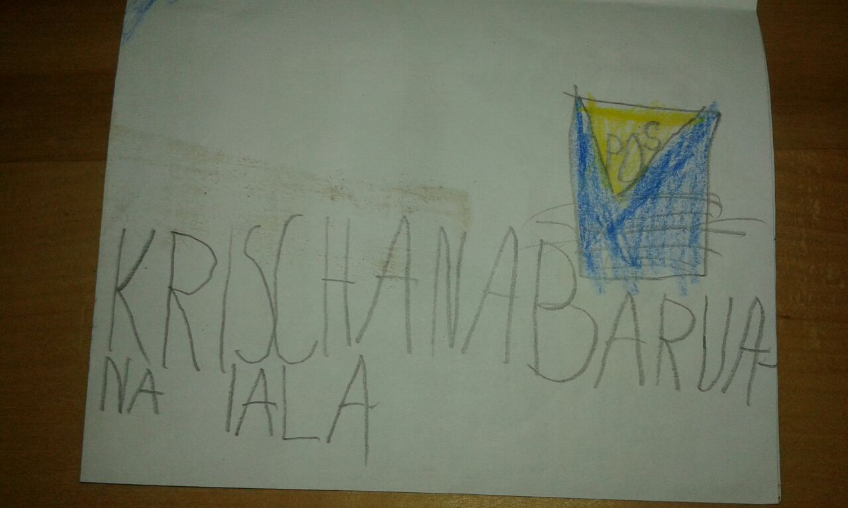
2.3 Language Practices: Real Life vs. Expectations
Example 1
Bilingual (Latvian and German) 7 years old child writes the name of the street in Rīga: Krišjāņa Barona iela

Slide 13
2.3 Language Practices at School: Real Life vs. Expectations
Example 2
For the Latvian lesson, a boy (9 years old, Grade 3) has to prepare a collage about a topic of his own choice. He chooses to tell about last weekend which he spent together with his father visiting Tallinn. He uses pieces from a booklet about the zoo, the old town, Kalev candy paper, entrance tickets from a football match and more.
The teacher says that it is interesting, there is only one drawback, there is not enough Latvian in the collage…

Slide 14
2.3 Language Practices at School: Real Life vs. Expectations
Example 3
In Daugavpils, January 2019; Latvian lesson
Students of grade 12, when speaking on the subject of ‘Communication Barriers’, use short videos in English (talking about different cultures, religious attitudes in different cultures, people who speak sign language, etc.).
At home students watched those videos in English, during Latvian class they analyze, discuss diverse cases in Latvian.

Slide 15
2.3 Language Practices at School: Moving Forward
Expectations by the new standard:
Competence in pluriliteracy – literacy in more than one language or script
Moving from monoglossic towards a heteroglossic ideology
Translanguaging as a pedagogical tool
Intensify the use of students' linguistic repertoires not only in language classes but also in other subjects
More multilingual practices, e.g. through the pedagogical use of code-switching and recognition of diverse language resources

Slide 16
2.3 Language Practices at School: Moving Forward
Examples from the new programmes for Latvian: Secondary school (Grades 10-12)
Investigate how different documents define/understand terms such as: state (official) language, minority language, autochthonous language, foreign language, sign language. Explain your understanding of these terms with your own words and illustrate your explanations with concrete examples from the language situations in Latvia or other countries.
Create your own language biography (if you wish, in multimodal form, using digital tools), present it and explain each of your languages‘ relevance for your life and the creation of your identity.
Discuss different types of identity (gender, social, ethnic, civil, territorial, linguistic, contextual) and the role of specific languages and cultures in your identity formation and when displaying them to others. Create a summary – which factors have the biggest influence on the creation of personal and social identity?
Discuss how the perception of specific identities may influence life together with other persons. Provide definitions and examples of how a tolerant attitude can be recognized.

Slide 17

2.3 Language Practices at School: Moving Forward
Examples of student-made language biographies: Laine and Amanda
Laine:
Zviedru valoda
Krievu valoda
Latviešu valoda
Franču valoda
Ukraiņu valoda
Lietuviešu valoda
Vācu valoda
Angļu valoda

Slide 18
3 Short Summary
School is behind reality regarding what happens outside the classroom window: we are reading, watching, observing, listening, speaking, writing in more than one language every day
We should at least sometimes encourage students to choose different languages or their entire linguistic repertoires during school work
Students can reach deeper understanding of concepts in many subjects when comparing definitions or explanations in more than one language
The Value of Language: educators and students often live in very different realities
The creation of new school standards and curricula aims at bridging the gap between school and «real life»
Current practices at school as well as existing ideologies / attitudes are strong obstacles in the process of convincing society of the need of modernization

