Slide 1


Multilingualism in an international company
Case of Pipedrive
MIRJAM LAURISAAR・TALENT ACQUISITION TEAM LEAD
Notes:
Presentation Cover 1

Slide 2
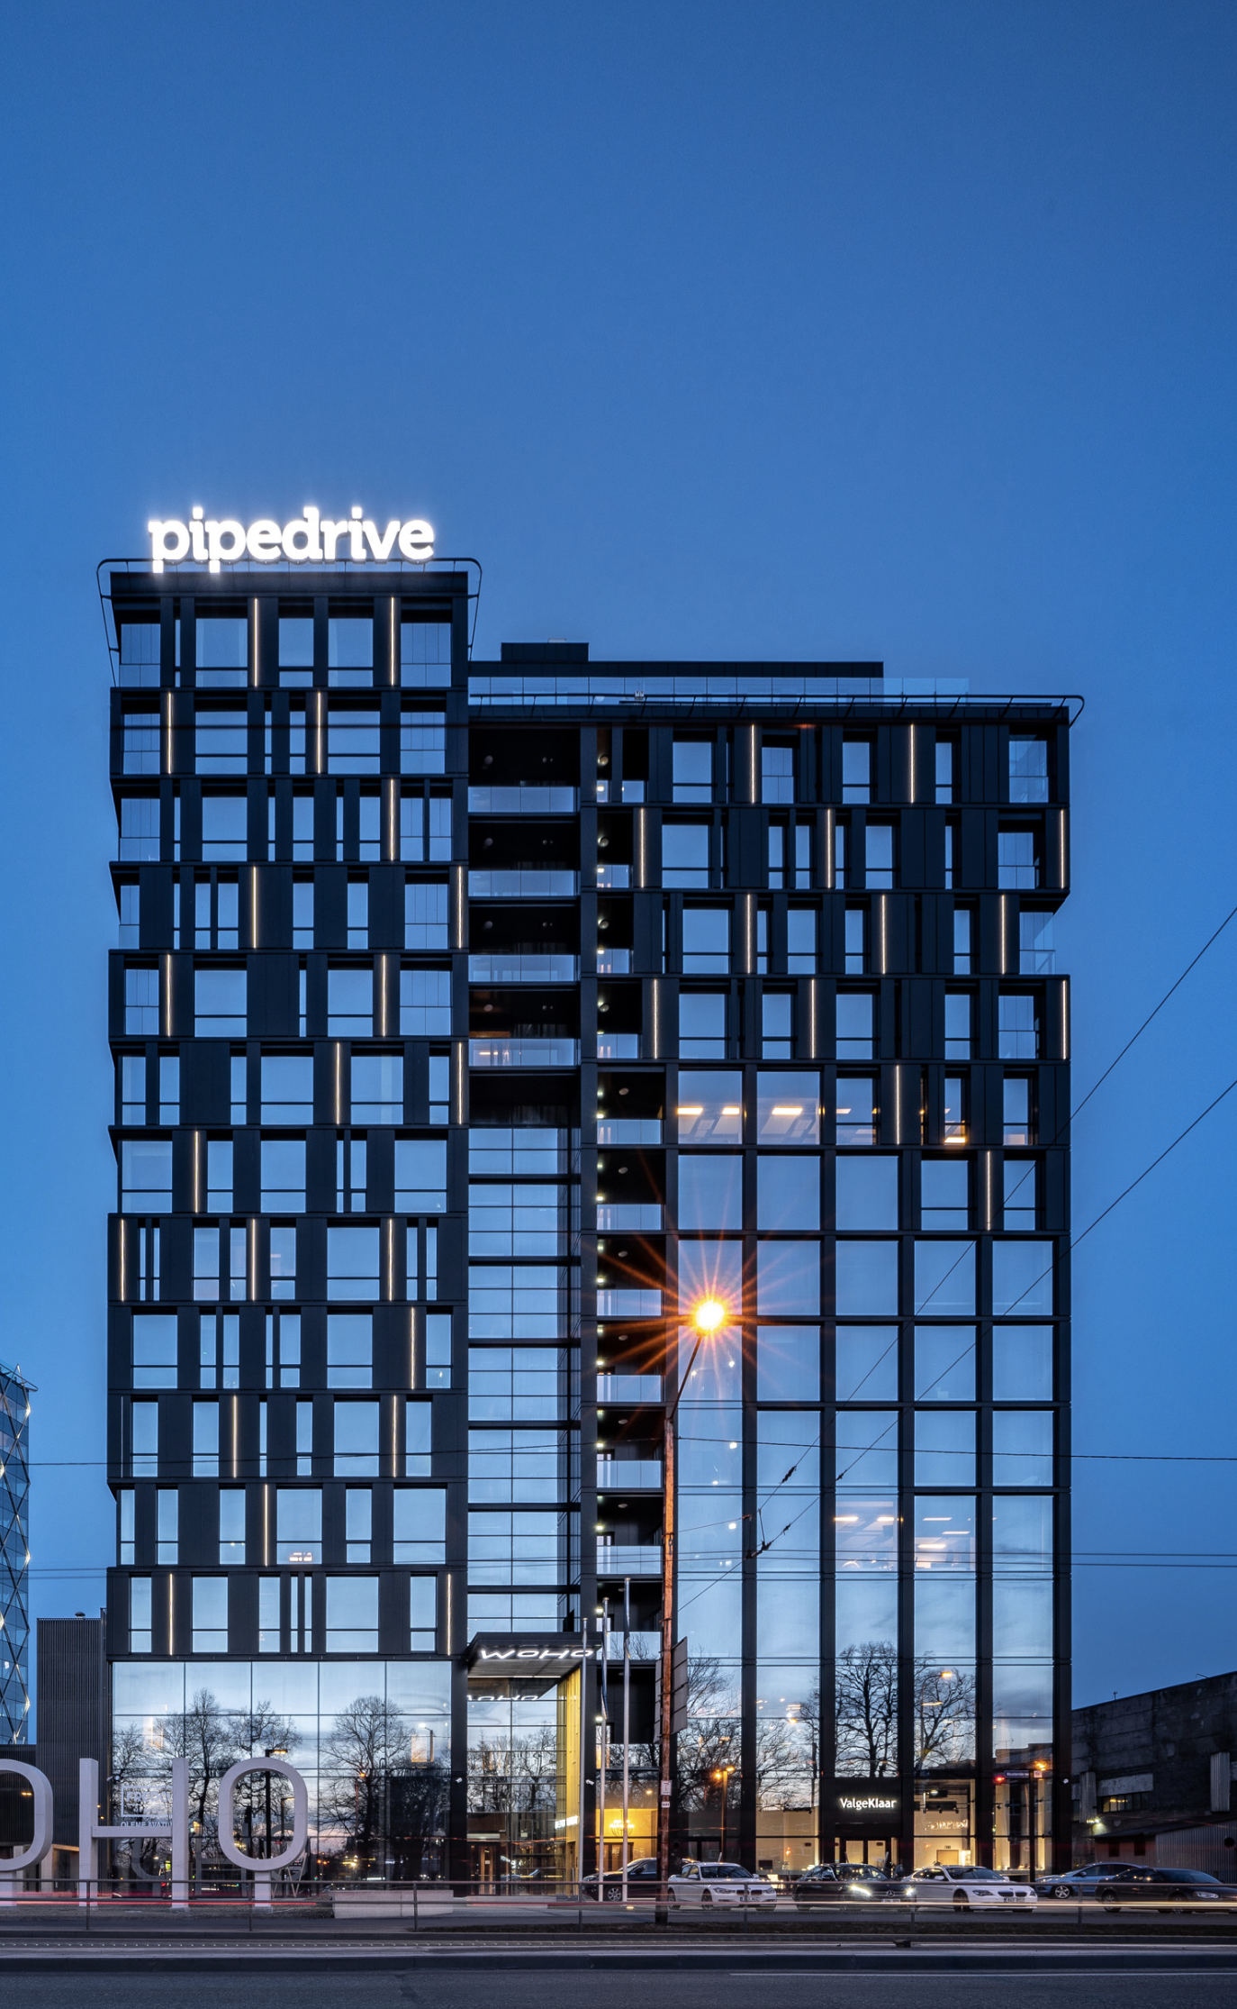
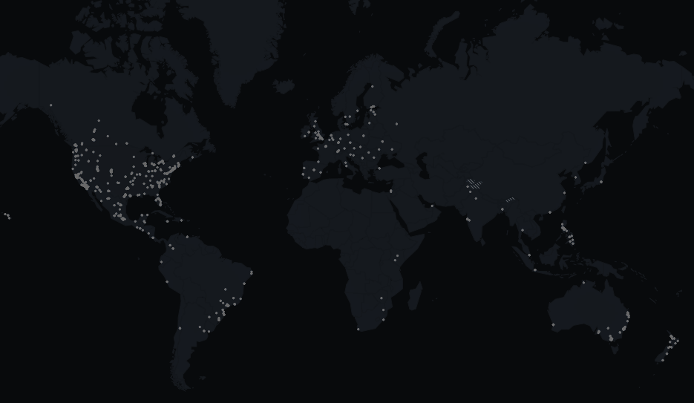
Sales CRM tool
Founded in 2010
Best employer in Estonia

Slide 3
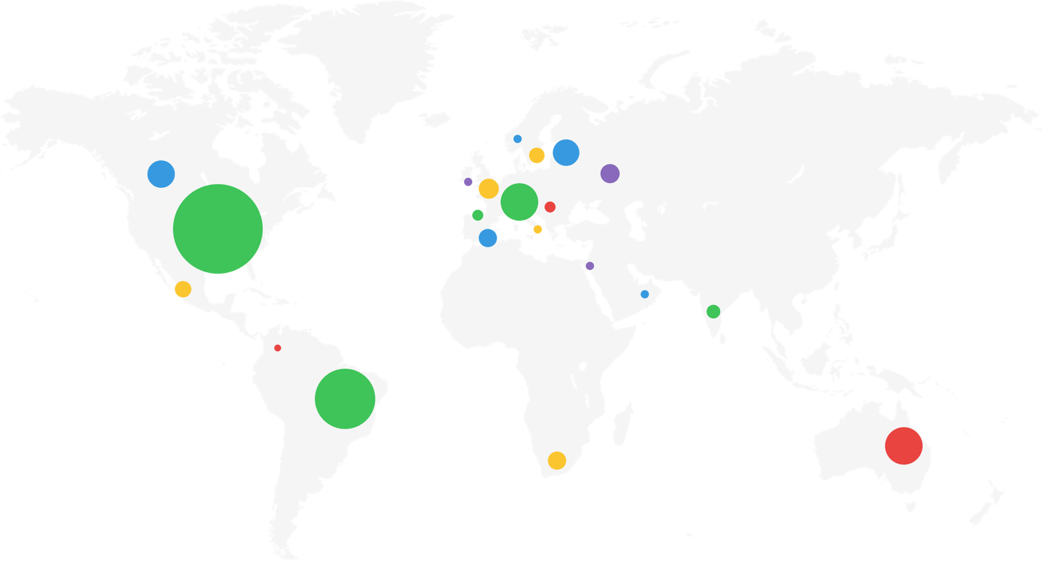
Exactly how global are we as a company?
16 languages, multiple currencies
Over 170 countries covered
Over 90,000 customers
600+ employees
8 offices in 6 countries

Slide 4
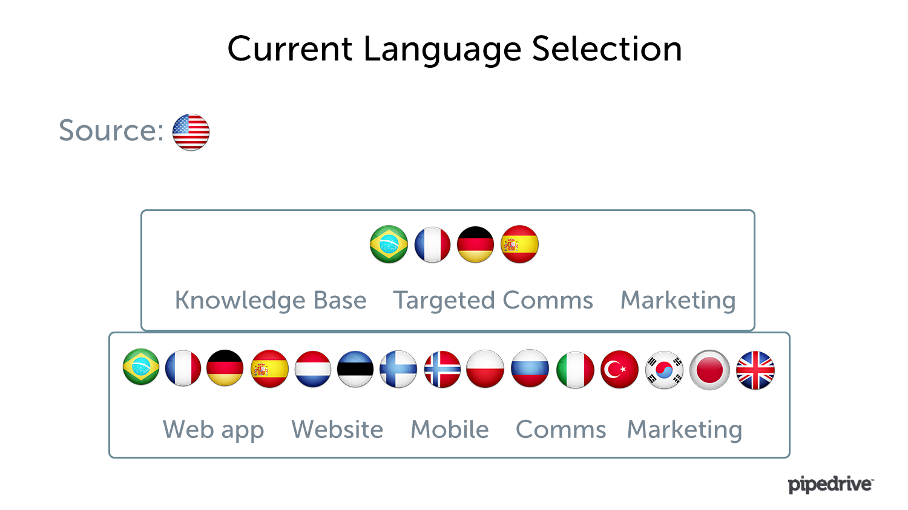

Slide 5
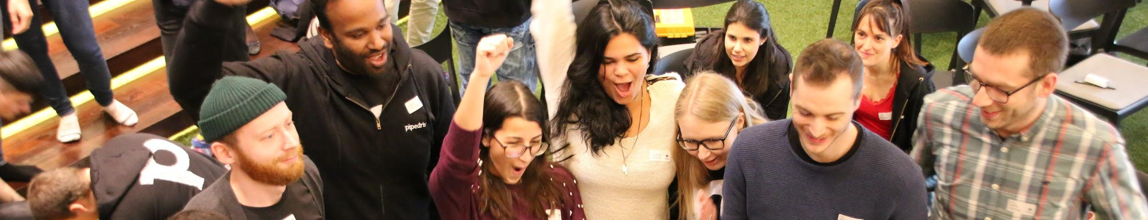
Diversity in Pipedrive
360
45
34%
28
Pipedrivers in Estonia
different nationalities amongst Pipedrive Estonia employees
of employees are not Estonians by nationality
Pipedrivers relocated to Estonia during 2018
Was the most popular country to hire from in 2018 and 2019
India

Slide 6
Challenges of a global company
Creating and maintaining a unified culture
Language
Communication
Maintaining Estonian identity

Slide 7

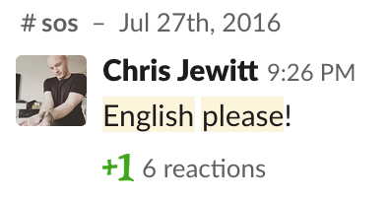
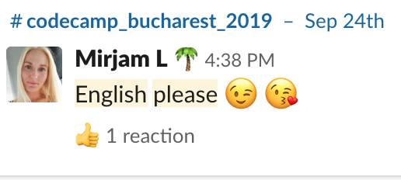
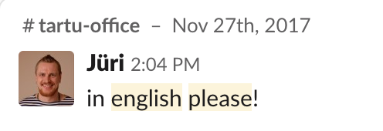
Languages at Pipedrive
English is the Lingua Franca and official language for all internal communication
Russian, Spanish, Portuguese follow
Notes:
External events, internal events
All written and oral comms
We encourage people to always stick to English
Even if it is for one person
We hire people bearing in mind diversity. To include more nationalities and make sure one language outside of English does not dominate too much.

Slide 8
The upside of English as a corporate Lingua franca
Ease of communication
Supports inclusion
Supports diversity
Ease of integration
Creating a unified culture

Slide 9
And the downside
English jargon creeps its way in
Forgetting Estonian vocabulary
Difficulty in expressing oneself in Estonian
Estonian as the language of the “coffee corner”
Expats find less opportunities to practice Estonian
Minorities start switching over to English more frequently
Notes:
I made this presentation in English
Had to talk once to a group of Estonians, didn’t know it. I had prepared my presentation in English and it was challnging to switch to Estonian.
Work jargon
Sometimes we find Estonians speaking to each-other in English
Work emails, even doing interviews tends to be more complex in Estonia

Slide 10
What about Estonian language?
65% of employees are Estonian
Estonian language classes
Estonian culture sessions
Language of the ‘Coffee Corner”
Supports integration

Slide 11
Summary
English
Is preferred and encouraged.
“The professional language”
Making our day to day communication a lot simpler
Creates a unified culture
Estonian
Spoken widely, but mostly among Estonians
Influence of English visible
Threat of becoming the language of the ‘non-work talk”
Estonian language and culture classes
Supports integration
Notes:
Regular Slide

Slide 12
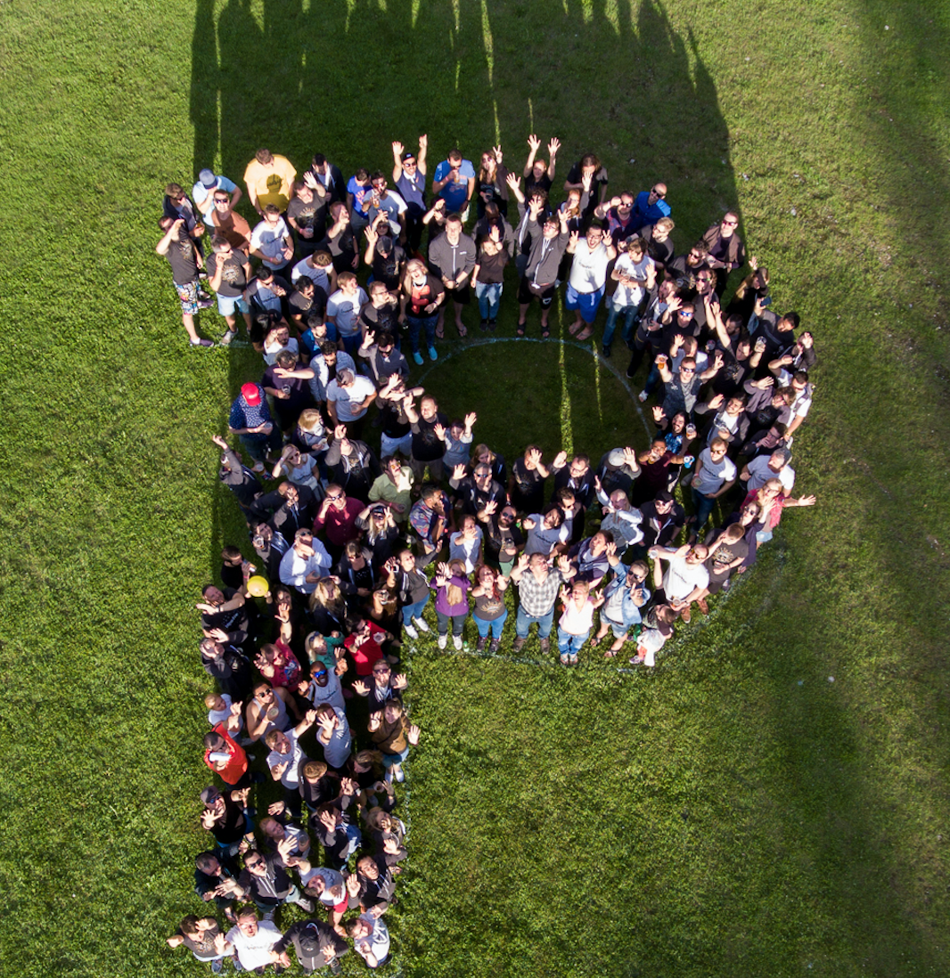

Thank you!
© 2019 Pipedrive. All rights reserved.

