Slide 1
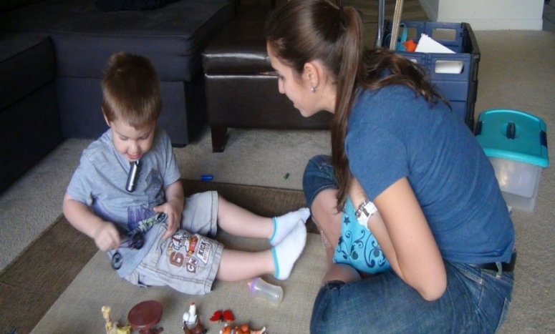
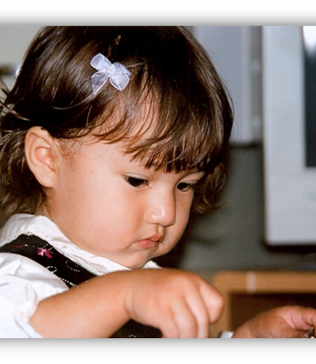

The Nature of Dual Language Skills at School Entry among Children from Language Minority Homes
Erika Hoff, Florida Atlantic University
Shared Language: Integration Through Multilingualism, November 14 – 15, 2019, Tallinn, Estonia

Slide 2


Acknowledgements
Cynthia Core, The George Washington University
Justin Lauro, Florida Atlantic University
David Giguere, California State University-Sacramento
Michelle Tulloch, Florida Atlantic University
Staff and students in the Language Development Lab, FAU
The Eunice Kennedy Shriver National Institute of Child Health and Human Development

Slide 3
The starting point
Many children, in many countries, hear a language at home that is not the majority language of the country in which they live, nor is it the language used in the schools they will attend.
Many of these children have difficulty when they enter school, and poor majority language skills are clearly part of the reason why.
Why is this the case, and if we understood why, would that help us do anything to improve the situation?

Slide 4
The current longitudinal study
  120ish children from Spanish-speaking homes in the U.S.; one or both parents was a native Spanish speaker born in a Spanish-speaking country
  39 children from monolingual, English-speaking homes
  Children were visited every 6 months from 2 ½ to 5 years
  We interviewed the mothers for the standard demographic information and about language use in the home
  We administered a battery of researcher-designed and standardized tests to the children

Slide 5
  Measures of children’s language environments
    Relative exposure to English and Spanish at home –reported by caregiver
    Maternal education – in English and in Spanish
    Child’s birth order
  Measures of children’s language learning ability
    Phonological memory--assessed in nonword repetition task at 2 ½, for English-like and Spanish-like nonwords
    Nonverbal IQ—standardized test administered at 5 years

Slide 6
Things to know about the Spanish-speaking sample
89% of mothers were native Spanish speakers
75% of fathers were native Spanish speakers
Socioeconomic status (SES) varied; on average this was not a low SES sample
77% of mothers had a college degree or higher
  36% earned in English
  33% earned in Spanish
  8% in English and Spanish
On average, homes were Spanish dominant, but Spanish use ranged from 100% to 10%
50%

Slide 7
What these data can tell us
They can provide a description of the course of English and Spanish language development for children in this circumstance.
They can identify factors support growth in each language.
They provide a description of the patterns of dual language skill that characterize bilingual children at age 5 years.
They identify predictors of those patterns—the patterns that are the nature of these children’s dual language skills at school entry.

Slide 8
A description of the course of expressive vocabulary growth in English and in Spanish
N = 39 monolingual children and 126 bilingual children (Lauro, Hoff, & Core, under review)

Slide 9
Factors that support language development:
Effects of relative home exposure
Hoff & Ribot, 2017, Journal of Pediatrics

Slide 10
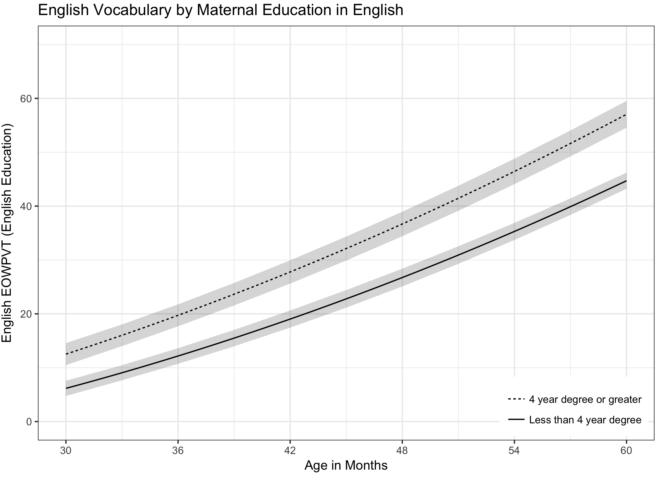
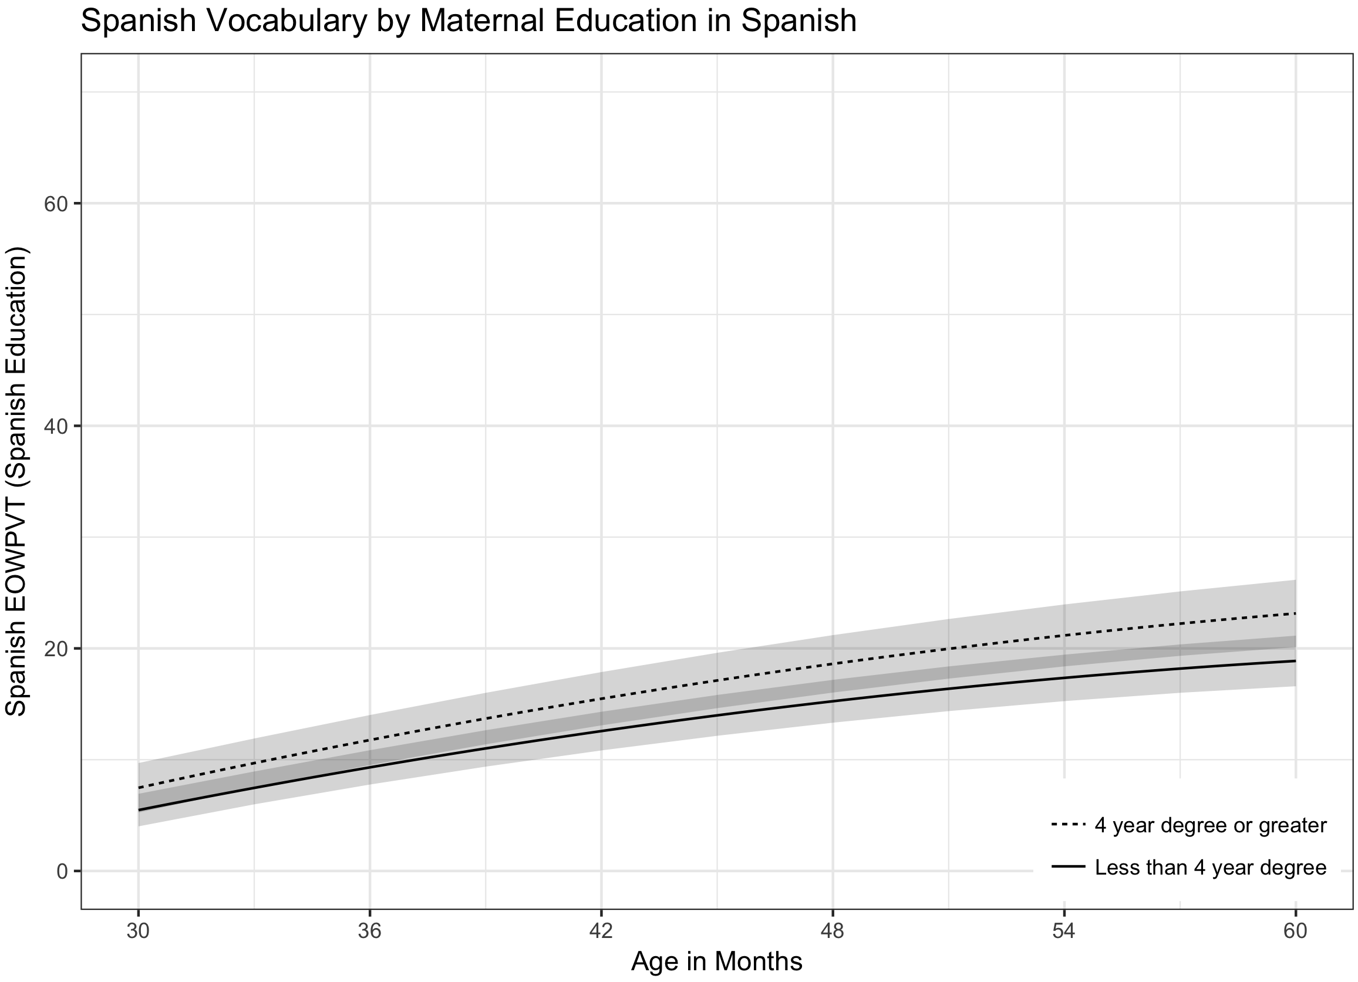
Factors that support and hinder language development:
Effects of maternal education, only in the outcome language (N = 92 immigrant mothers)
Hoff, Burridge, Ribot, & Giguere, 2017, Developmental Psychology

Slide 11
Factors that support language development:
Effects of children’s phonological memory skill
English
Spanish
Lauro, Core, & Hoff, under review

Slide 12
In summary, predictors of English and Spanish skill levels during this preschool period
Characteristics of the environment
  Relative amount of language exposure
  Maternal education in the language of the outcome
Characteristics of the child
  Phonological memory
  Nonverbal IQ (for English only)

Slide 13
Now, turning to bilingual skills – instead of looking at each language separately

Slide 14
Now, turning to bilingual skills – instead of looking at each language separately
Remember the growth trajectories for each language………

Slide 15
Those trajectories produce the following patterns of dual language skill at 2.5 and 5 years
Children become more English dominant, on average

Slide 16
What about individual differences in those patterns? –at 5 years
Spanish vocabulary and English vocabulary are unrelated, r (126) = -.011
All patterns of high and low English and Spanish skills are possible
Individual children vary on two dimensions

Slide 17
Cluster analyses suggest children are not smoothly distributed over this space
You can identify profiles of dual language skills

Slide 18
What about individual differences in those patterns? –at 5 years
Hoff,Tulloch, & Core, in preparation

Slide 19
Correlates of profiles at 5 years: child factors

Slide 20
Correlates of profiles at 5 years: child factors
Lower in nonverbal IQ
Lower in phonological memory
Higher in nonverbal IQ
Higher in phonological memory

Slide 21
Correlates of profiles at 5 years
Higher English exposure
Higher proportion of maternal schooling in English
Higher Spanish exposure
Higher proportion of mothers with Spanish college degrees

Slide 22
Correlates of profiles at 5 years: home environment factors
More Spanish exposure
More maternal schooling in Spanish
More English exposure

Slide 23
Comparison to monolingual majority language skills
50th percentile for English, roughly

Slide 24
A final note about the nature of bilingual skills: Receptive skills are often stronger than expressive skills

Slide 25
What are the language skills of children from minority language homes at school entry age?
They are very heterogeneous – average descriptions tell you little about individual children
Some children will have majority language skills that are comparable to the skills of monolingual children with native parents
Most will not
And, they will differ from monolingual majority language speakers in multiple ways

Slide 26
Does this knowledge help us in any way?
Many children from minority language homes will need extra support for majority language development from outside the home.
That support is more valuable if it comes from speakers who are educated and proficient in the majority language.
You need not fear the minority language.
You should not assume you know the child’s language skills or language learning ability based on expressive skills in one language.

Slide 27
Thank you

