Slide 1
East and Central European Studies
Charles University, Faculty of Arts
Prague, Czech Republic
Managing Communication During a Crisis
Presented by Martina Provázková

Slide 2
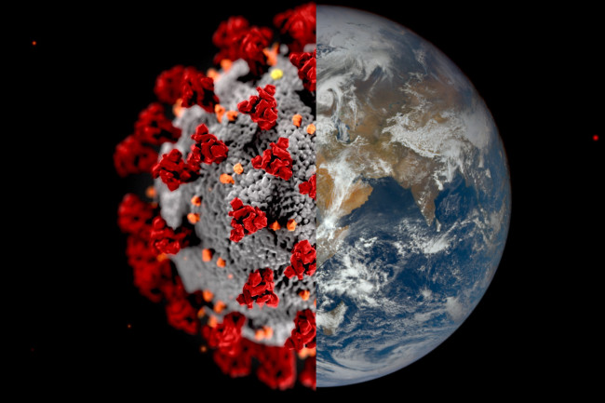
Introduction in Numbers
100 students
30 courses
25 teachers
5 team members
3 days
6 500 km
6 hours
1 virus

Slide 3
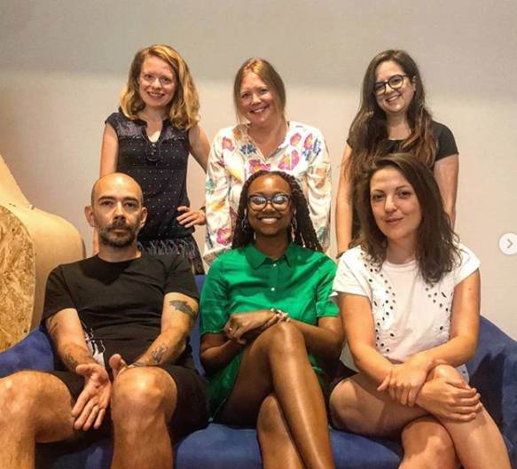
Analysis of our roles and our technical equipment
Team members
Equipment
Budget

Slide 4

3 most important things you need
Stay Calm
Use Your Logic
Be Organized

Slide 5
3 days of hard work
Wednesday – Thursday – Friday March 11th to 13th
 | Student Support | Teacher Support | Partner Support | Technical Support | Communication and PR
Ivana | X |  | X
Sasha | X |  | X |  | X
Lukáš | X | X |  | X
Martina | X | X
Zuza | X |  |  |  | X

Slide 6

Making the Transition Online After 30
Years Completely Offline
Strong program structure
Streaming platform Zoom
New schedule according to US time zone
Clear instructions for teachers and students (Zoom meetings, program website, emails)
Non-stop support

Slide 7
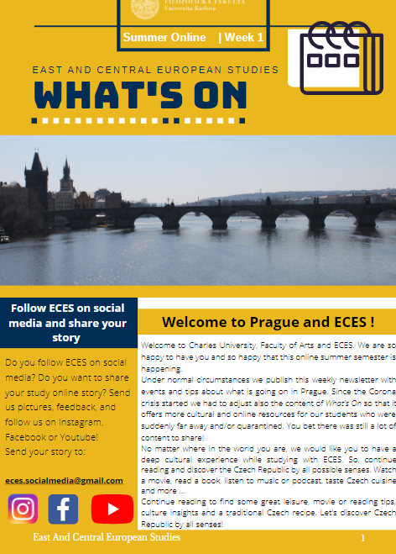
Students' Virtual Experience in Prague
What’s On
Instagram

Slide 8
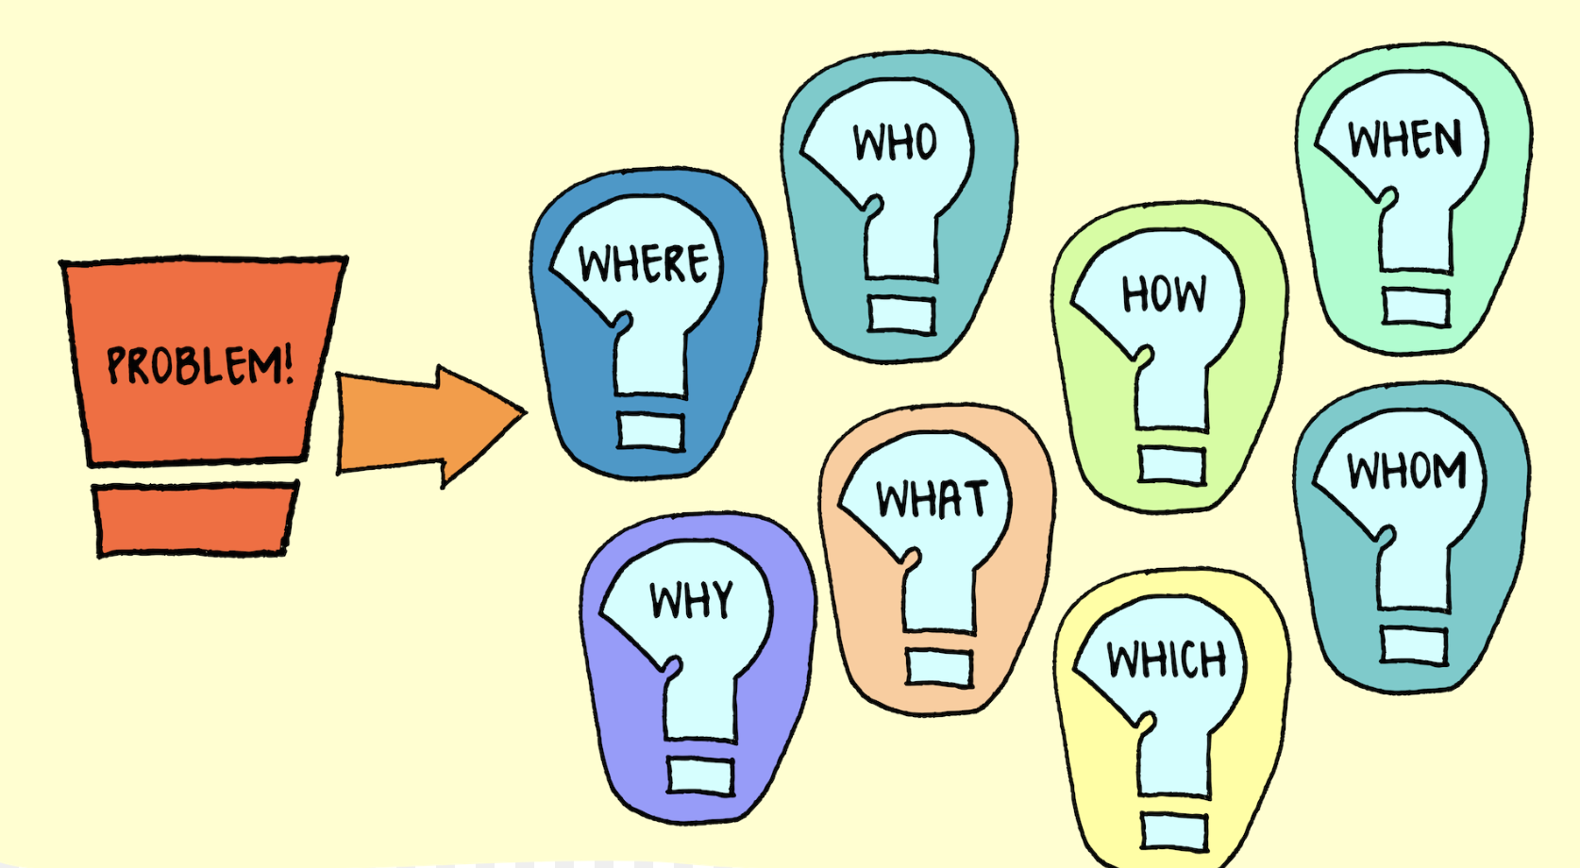
Most common problems
Unread emails
Bad timezone conversion
Non-functioning internet

Slide 9

Student Feedback
Mostly positive
Minor misunderstandings about finals and midterms between students and teachers
ECES program should not have been so active and left 1 week free for students to rest and recover after the journey home and the first shock of coronavirus

Slide 10
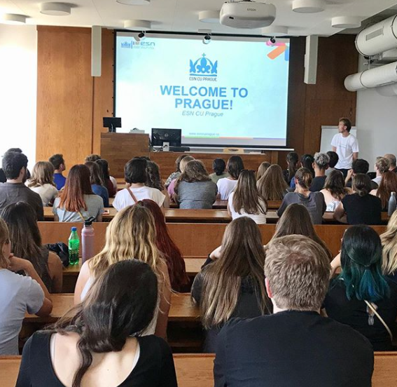
Teamwork makes the dream work
Students
Teachers
Team
University support

Slide 11

Thank you for your attention.
Do you have any questions?

