Slide 1
East and Central European Studies
Charles University, Faculty of Arts
Prague, Czech Republic
Effectively Communicating with a Diverse Audience in International Higher Education
Presented by Sasha Hlozek

Slide 2
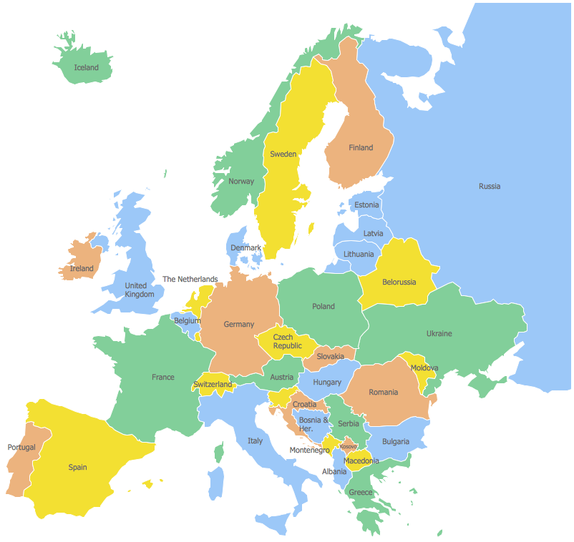
Reasons International Students Choose to Study in Prague
Relatively inexpensive for a European capital
A blend between Eastern and Western Europe
Home to many cultural and social events and activities
Located in the center of Europe
Erasmus v. ECES

Slide 3

Charles University, Faculty of Arts (FFUK)
Oldest university in Central Europe, founded in 1348 by King Charles IV
The most prestigious university in the Czech Republic
Public university with 50,000+ students
One of the four original faculties, and currently the largest

Slide 4

East and Central European Studies (ECES)
Founded in 1992
An English-taught program at FFUK for non-degree seeking students
Offers courses in the humanities, including history, literature, politics, Czech language, sociology
Runs semester, summer and customized sessions
Facilitated by the International Relations Office at the Faculty of Arts

Slide 5
ECES Student Services
24-Hour emergency support
Comprehensive pre-departure orientation including visa advising (if applicable)
1-week (summer/J-term) or 3-week (semester) on-site orientation
On-site housing assistance
Medical assistance

Slide 6
Extracurricular Activities with ECES
Semester:
Two day trips included during orientation
Optional trips and activities available throughout semester
Café and Gallery excursions
Charles University International Club events
Film screenings
Lectures

Slide 7

Communication Audiences
Partner universities
Partner third-party providers
Students
Professors
Academic board
Service provider partners (travel, events, etc.)

Slide 8
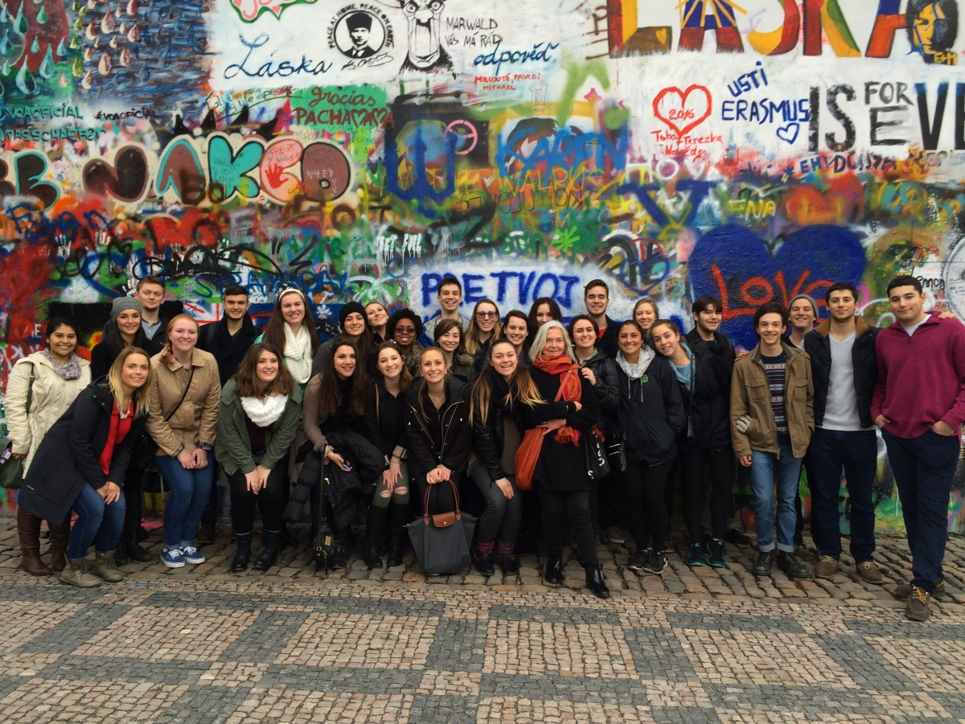
Communication Timeline
Communication begins with students months prior to arrival in Prague.
  Pre-departure advising
Proactive vs. Reactive communication
Post-semester communication

Slide 9
Differences to Consider
Communication style
Attitudes toward conflict
Approaches to completing tasks
Different decision-making styles
Attitudes toward disclosure/privacy

Slide 10
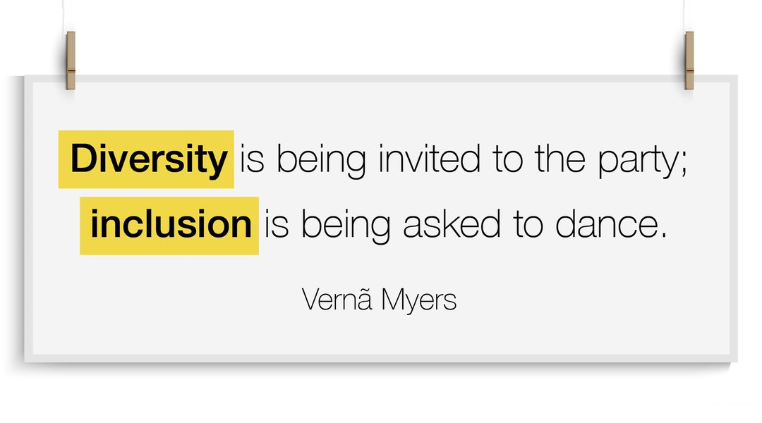
Diversity + Inclusion
Diversity + inclusion
Students of various ethnic, racial, religious and socio-economic backgrounds

Slide 11
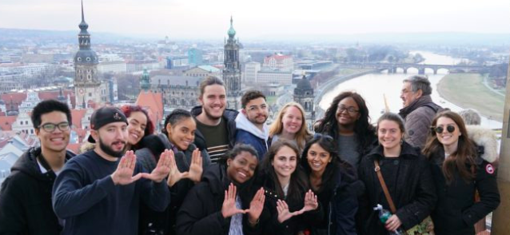
Diversity at ECES
ECES is committed to supporting students who are ethnically and racially diverse, first-generation college attendees, high-financial need, LGBTQ, religiously diverse, or who have a disability.
Inclusion and equity leads to student success and confidence, and therefore alumni success.
Our pre-departure orientation and orientation week emphazise health and safety for a diverse group of students.

Slide 12
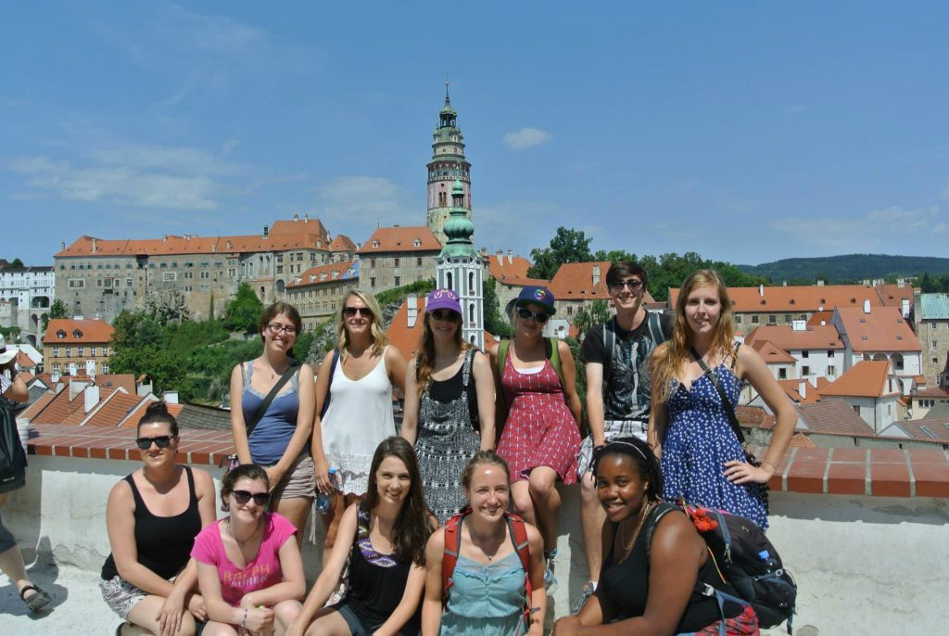
Inclusion at ECES
Religious diversity
  Offer courses such as Jewish History
  Dormitory accommodations possible
Socio-economic diversity
  Offer free or low-cost activities accessible to all
Racial diversity
  Providing safe space for discussion
  Inclusive promotional materials
First-generation students
  Providing more detailed orientation information

Slide 13
Key Takeaways
Know the diversity of the audiences with which you're communicating
Tailored messaging is most effective
Clear and transparent communication is key

Slide 14

Thank you for your attention! Questions?

