Slide 1
Media and solidarity in times of crises
Kaarina Nikunen
Professor of Media and Communication Research
Tampere University
Kaarina.nikunen@tuni.fi

Slide 2
Media provide the possibility of knowing (Boltanski 1999)
Media hold significant role in providing information and understanding of social and political issues
How do we learn about society global events? How issues of immigration are framed in the media? Whose voice is being heard?

Slide 3
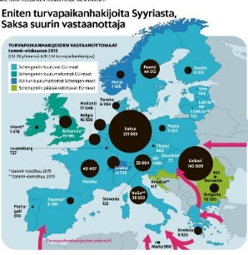
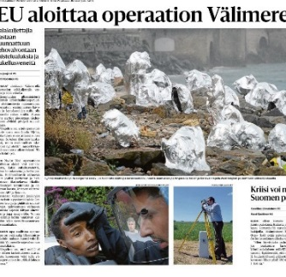
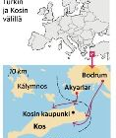
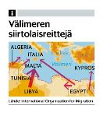
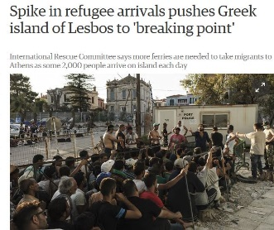
How are refugees depicted in the media?
Dehumanising imagery
  Perspectives of governance and control
  Metaphores of natural catastrophy: ’Flood, flow’
  Maps, graphs and numbers

Slide 4
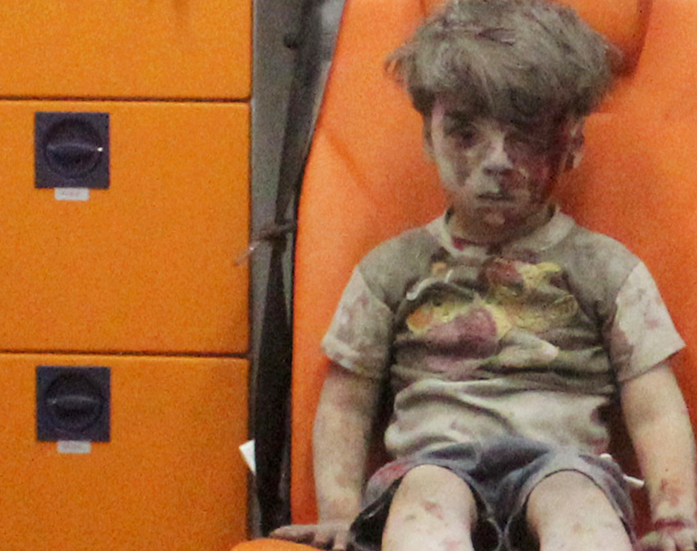
Sentimentality
  Emotional narrative
  Individual survival stories
  Gratitude, humility, victimhood
  ’Ideal’ victims: women and children
  Whose lives are worth grieving (Butler)?

Slide 5
Digitalization and datafication of media environment with complexconsequences to political cultures and public discussion: concurrently enhancing and deconstructing democracy and yhteisöllisyys
Social media particpation has created parrallel and conflictual debates and universes
Algorithmically shaped environment that creates distinct social worlds (Gillespie 2010; van Dijck & Poell 2013; Papacharissi 2014; Parisi 2011).
Growing mistrust to legacy media and governmental institutions: conspiracy theories, fake news, manipulation (Andrejevic 2013)

Slide 6
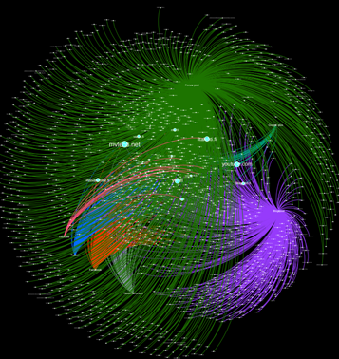
Rise of the far right
Making use of the logistical aspect of social media
Building communities of hate and transnational networks
Politically more influential than their size
Politics of irony (Nikunen 2015) politics of fear (Wodak 2015)

Slide 7
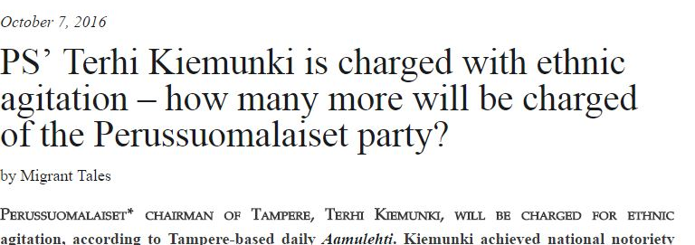
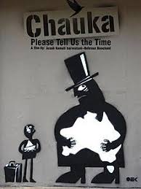
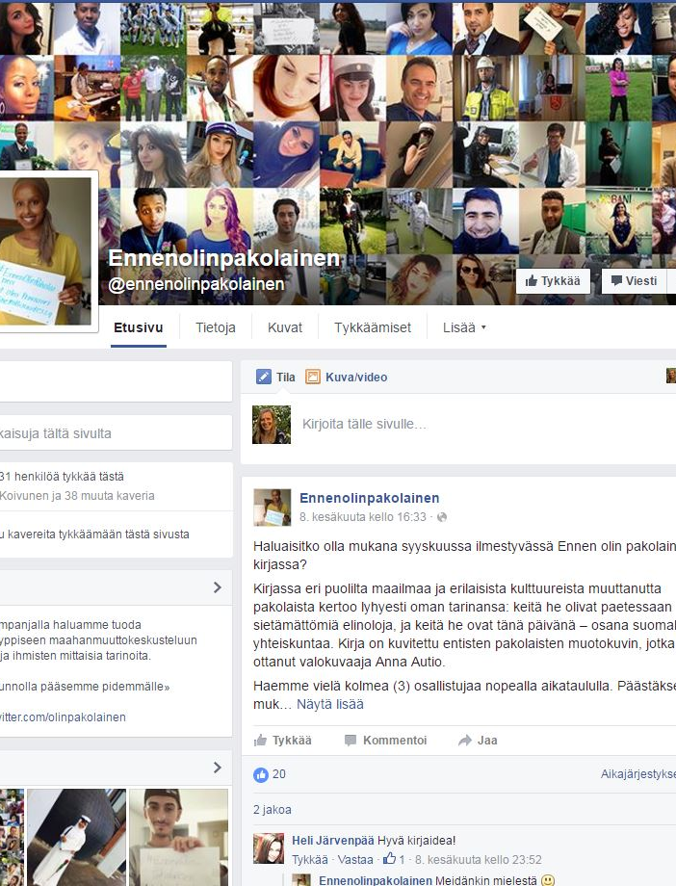
Solidarity movements and voices from the margins

Slide 8
How to create spaces of connection and solidarity?
Collaborative productions and forms of dialogue
Openness to new and unconventional productions
New practices of dialogue, collaboration, mutuality and listening – in the everyday
More inclusive practices: whose perspectives? Who are producing media news and narratives?
Instead of reacting to events, media should be able to provide new ways of imagining, discussing and producing futures in diverse societies.

Slide 9
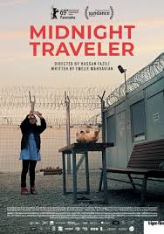
Social documentary
Fast growing area of media production
Connections between global events and local situations
Grassroot narratives
Collab0rations between media, art institutions and civil society

Slide 10
Thank you!
Kaarina.nikunen@tuni.fi
Nikunen, K. (2020) Media Solidarities: Emotions, Power and Justice in the Digital Age. London: Sage.
Nikunen, K. (2019) Breaking the Silence: From representations of victims and threat towards spaces of voice. In Georgiou, M. Leurs, K., Smets, K. & Witteborn, S. (eds) Sage Handbook of Migration and Media. London: Sage.
Nikunen, K. (2019) Once a Refugee: Selfie activism, visualized citizenship and the space of appearance. Popular Communication: The International Journal of Media and Culture 17(2): 154-170.

